Slide 1

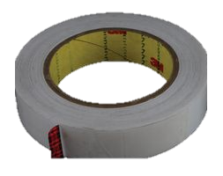
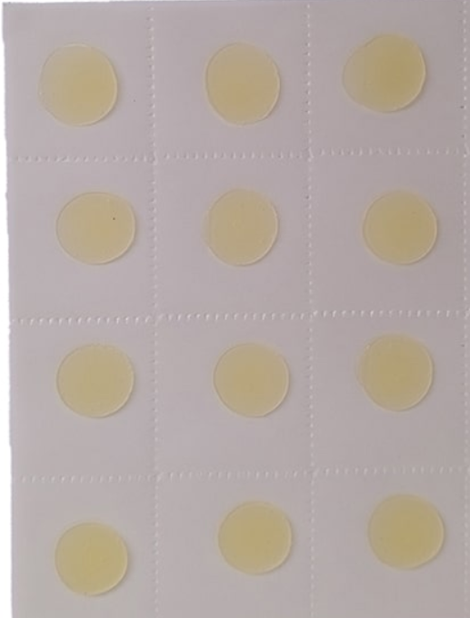
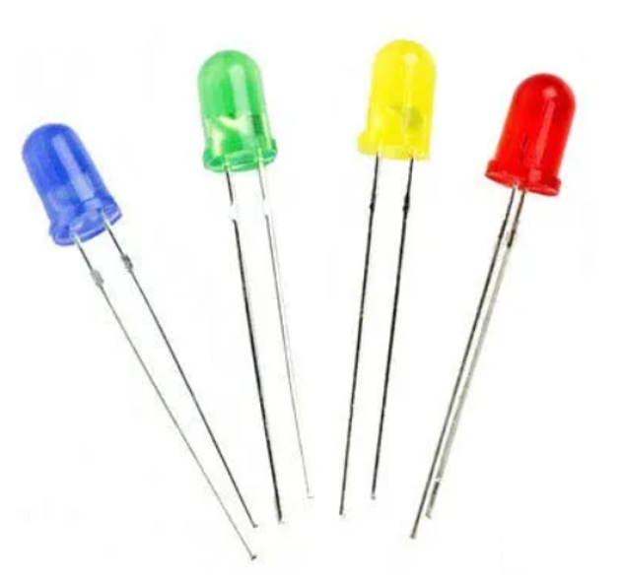

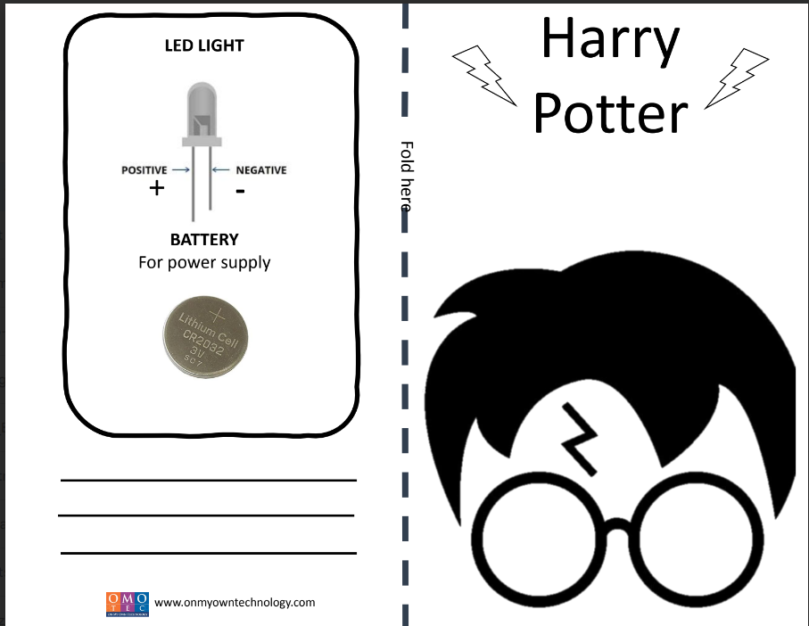

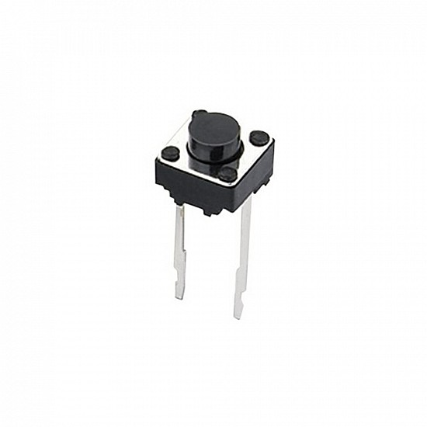

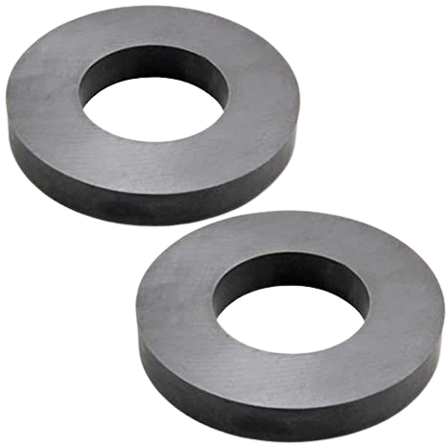
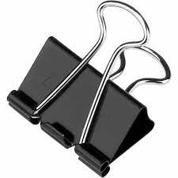
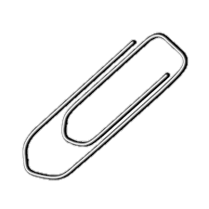
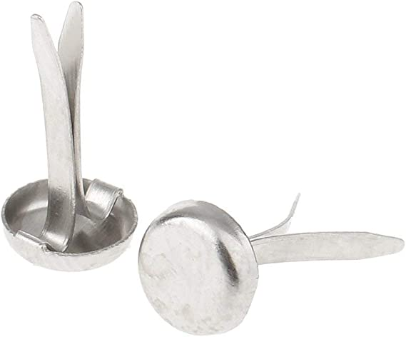

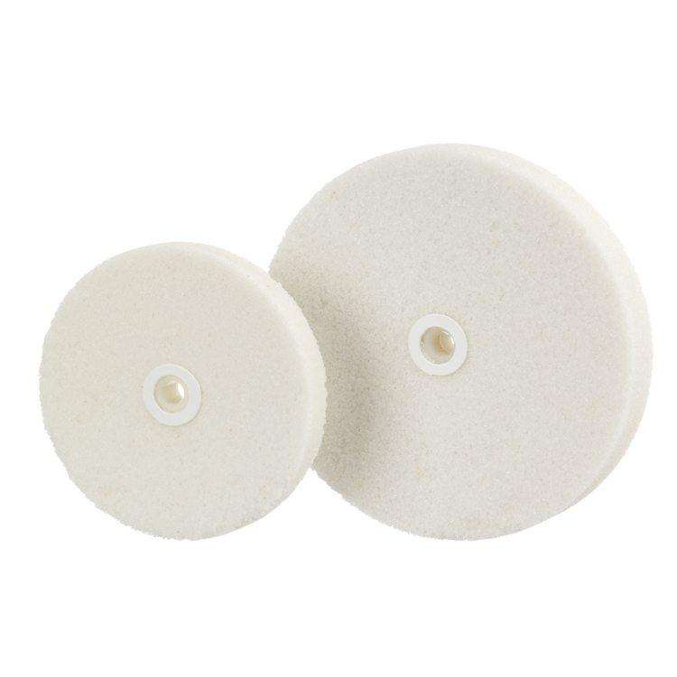
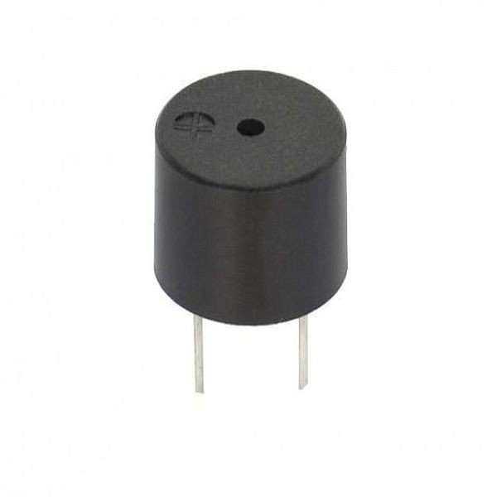
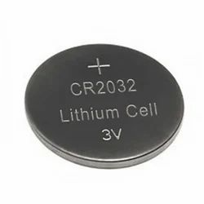
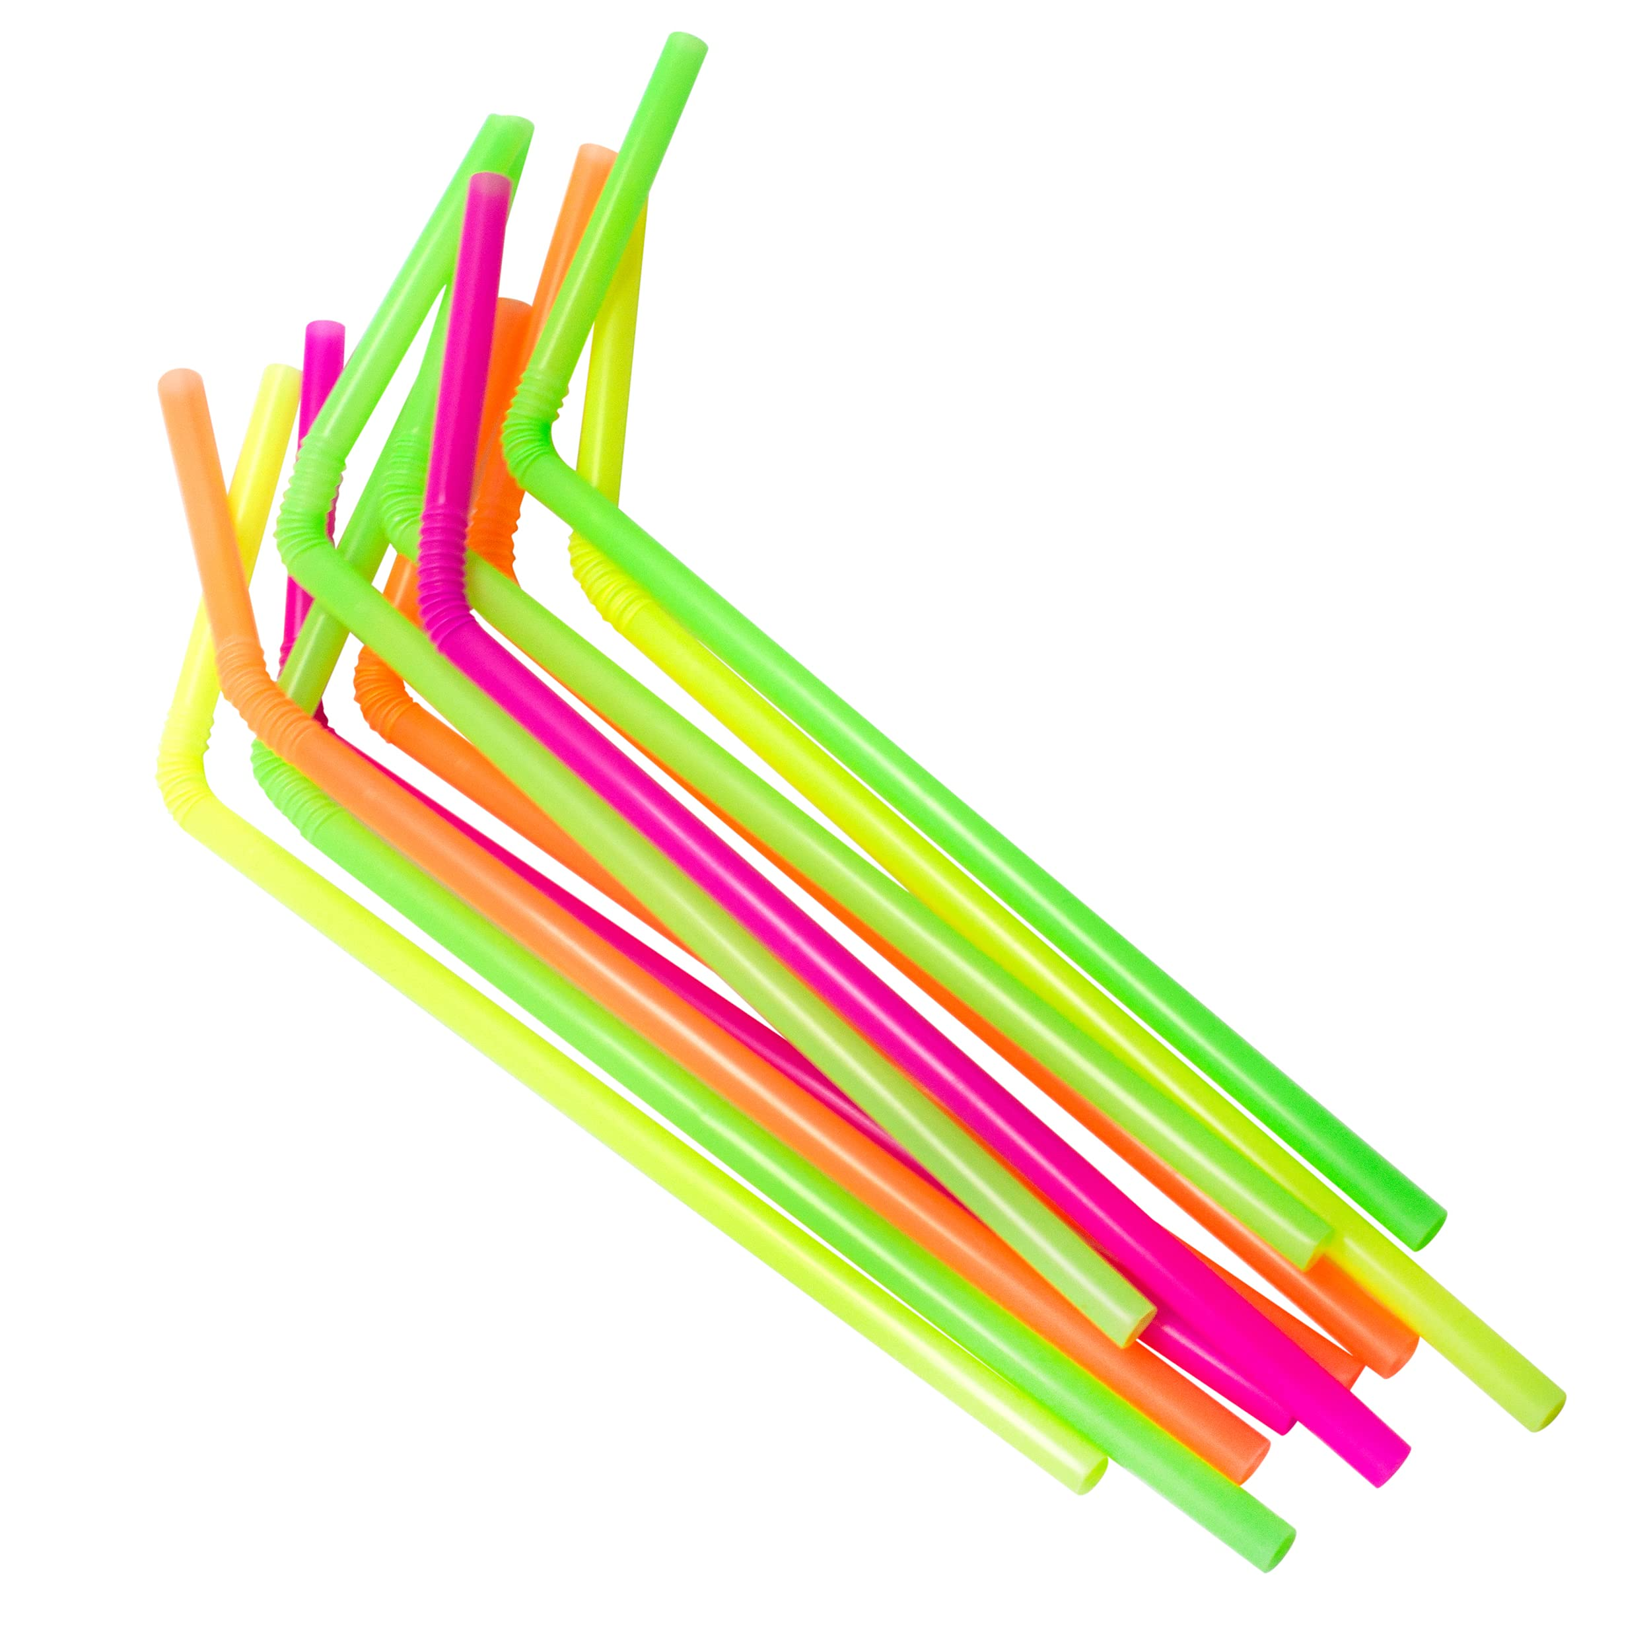
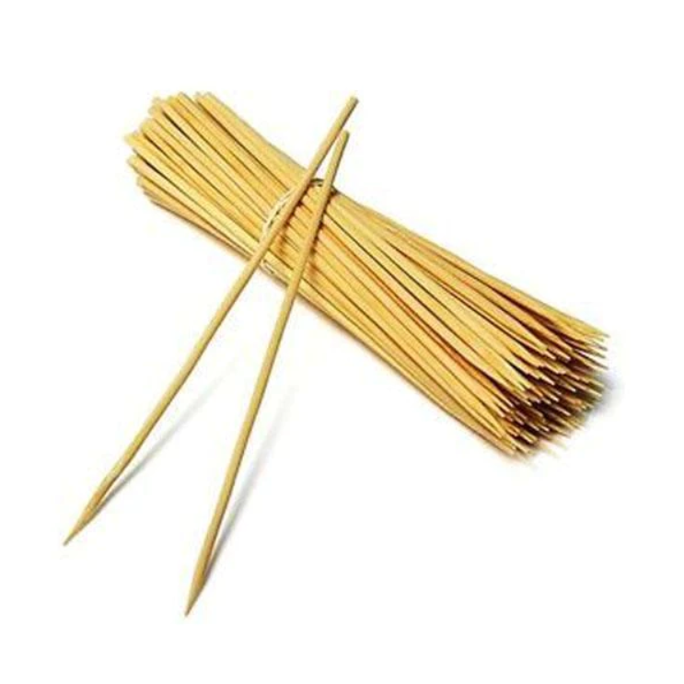
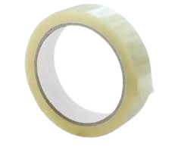
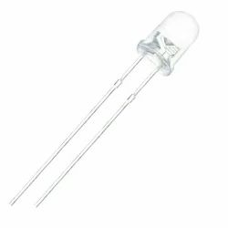
OMOTOOLS JR ELECTROKRAFT KIT
List of Component
1. LED
20 pcs
5. Conductive Tape
1 pcs
9. Thread
1 pcs
13. Glue Drop
24 pcs
2. Pushbutton
4pcs
6. Cardboard Sheet
2 pcs
10. Colours
1 pcs
14. Magnet
2 pcs
3. Buzzer Mini
1pcs
7. Paper Clip Set
8 pcs
11. Balloon
2 pcs
15.Acrylic Wheel
4 pcs
17. Circuit Paper
16 pcs
4. Multicolour LED
3 pcs
8.Coin Cell
5 pcs
12. Straw & Stick
6 pcs
16. Tape
1 pcs

Slide 2
OMOTOOLS JR ELECTROKRAFT KIT
1. LED
20 pcs
5. Conductive Tape
1 pcs
9. Thread
1 pcs
13. Glue Drop
24 pcs
17. Circuit Paper
16 pcs
2. Pushbutton
4pcs
6. Cardboard Sheet
2 pcs
10. Colours
1 pcs
14. Magnet
2 pcs
3. Buzzer Mini
1pcs
7. Paper Clip Set
8 pcs
11. Balloon
2 pcs
15.Acrylic
Wheel
4 pcs
4. Multicolour LED
3 pcs
8.Coin Cell
5 pcs
12. Straw & Stick
6 pcs
16. Tape
1 pcs

